Slide 1
Audio-based Out of Band Channel key exchange
Device pairing
02232 Applied cryptography, group 8
Troels Thomsen 152165
Rasmus Haarslev 152175
Vilius Maskovas 107154
Justas Mikalajunas 107083

Slide 2
Agenda
Device pairing
Goals
Solution
Solution overview
Solution analysis
Strengths
Weaknesses
Threat analysis
Device pairing 12-11-2015

Slide 3
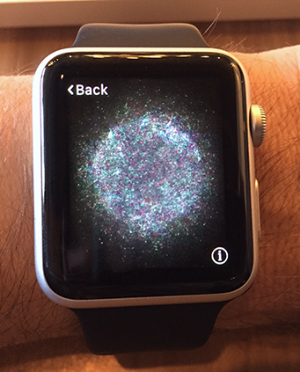
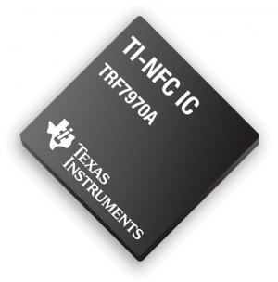
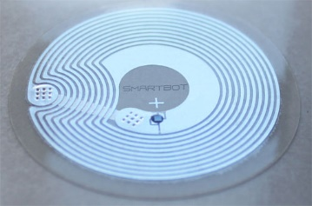
Device pairing
What is device pairing
Bits of history of device pairing
  Stajano, et al. The Resurrecting Duckling: Security Issues for Ad-hoc Wireless Networks (1999)
The most common method - Bluetooth: NC, PE, OOB, JW
Device pairing 12-11-2015

Slide 4
Goal
Replace JW pairing method
Solution - audio OoB channel
Device pairing 12-11-2015

Slide 5
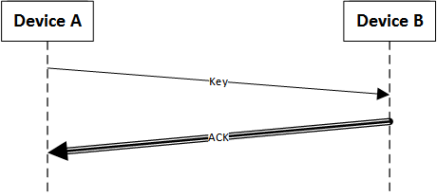
Solution
Simple
No human interaction needed
Fast
Secure
Device pairing 12-11-2015

Slide 6
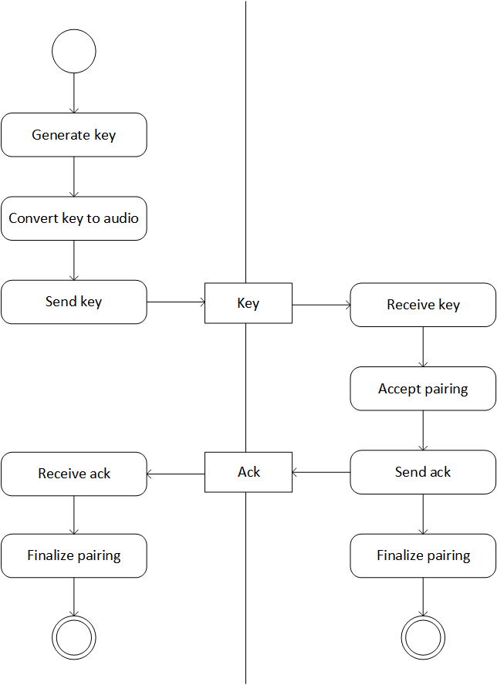
Solution Overview
-Audio key
-Base-100 encoding
-Audioi channel
-Inaudible frequencies
Device pairing 12-11-2015

Slide 7
Solution analysis
- OOB channel
- Base-100 encoding
- Inaudible frequencies
Device pairing 12-11-2015

Slide 8
Strengths
- OOB Channel
- Audio
- Proximity
- Backwards compatibility
Device pairing 12-11-2015

Slide 9
Weaknesses
- Sound quality
- Convenience
- Interference
Device pairing 12-11-2015

Slide 10
Threat analysis
- Eavesdropping
- Man-in-the-Middle
- Interference
Device pairing 12-11-2015

